Slide 1
The Entrepreneurial State: Debunking Public vs. Private Sector Myths
2022 Fall. National Innovation System
W15. Politics of Innovation
Mariana Mazzucato, 2015
Hyeonbin Park
STP, KAIST
December 6, 2022

Slide 2
Table of Contents
Author Introduction
Ch.3 Risk-Taking State: From ‘De-risking’ to ‘Bring It On!’
Examples
Conclusion and Discussion
1

Slide 3

1. Author Introduction
Mariana Mazzucato
Professor in the Economics of Innovation and Public Value at University College London (UCL)
Founding Director of the UCL Institute for Innovation & Public Purpose (IIPP)
Winner of many international prizes including: the Grande Ufficiale Ordine al Merito della Repubblica Italiana in 2021 (Italy’s highest civilian honour), 2020 John von Neumann Award, 2018 Leontief Prize for Advancing the Frontiers of Economic Thoughts
Authors of highly-acclaimed books in economics
2

Slide 4
1. Author Introduction
Public vs. Private Sector debates on their role in innovation and economic growth
Debunking the myth that the public sector is slow in innovation
Emphasizing the public sector’s role in promoting and producing innovation by drawing various cases; IT, biotech, nanotech, and green tech
3

Slide 5
2. Ch.3 Risk-Taking State: From ‘De-risking’ to ‘Bring It On!’
By investing in early-stage technology development, the public sector can create new products and related markets (63).
Risk-Taking State, not risk-averse, as an entrepreneur
4

Slide 6
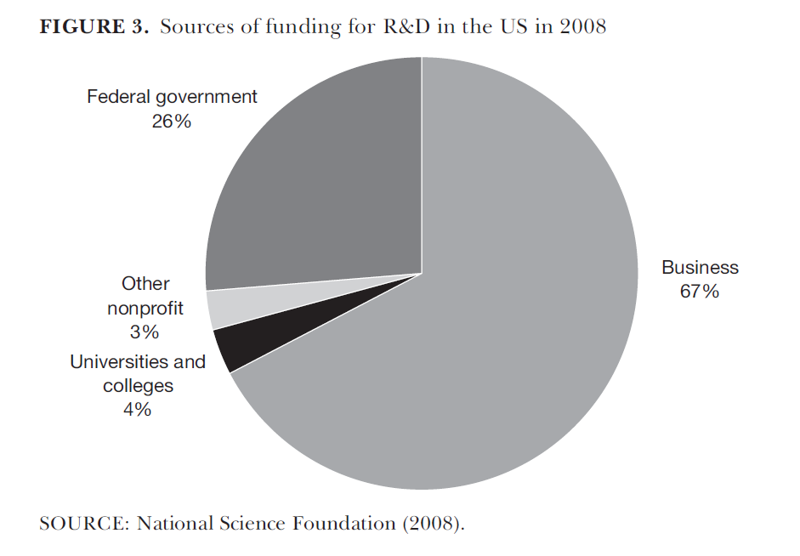
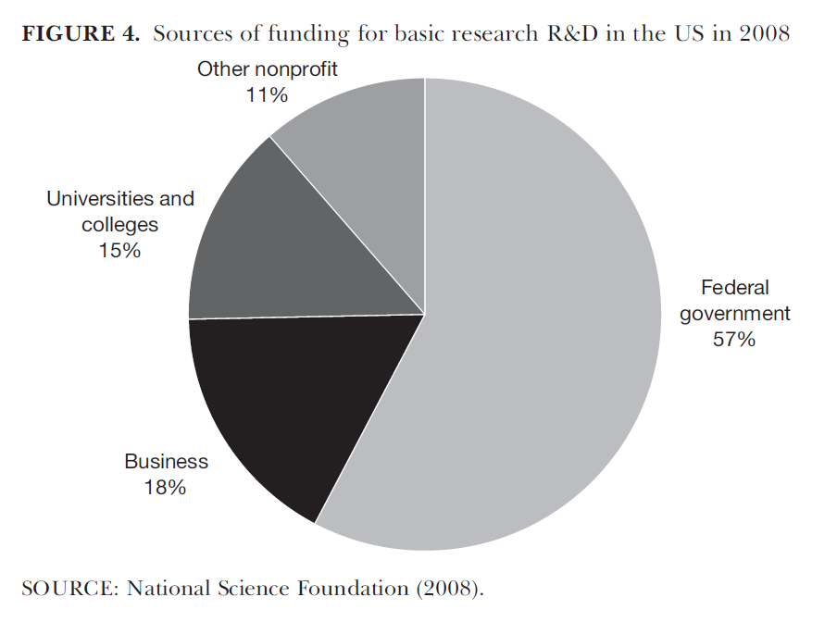
R&D Structure
5

Slide 7
R&D structure
mission-oriented projects: defense, space, agriculture, health, and energy
6

Slide 8
3. Examples in the history of innovation/ technology
Ruttan (2006) argues that large-scale and long-term government investment has been the engine behind almost every GPT (General Purpose Technologies) in the 20C; like electricity and computers
7

Slide 9
3. Examples in the history of innovation/ technology
Lazonick (2013) lists the cases where “the US Developmental State”;
the construction of railroads and financial support of agricultural research in the 19C
aeronautical, space, and aircraft industries in the 20C
life sciences, nanotechnology, and clean energy industries in the 21C
8

Slide 10
3. Examples in the history of innovation/ technology
Abbate (1999) shows how the internet grew out of the Defense Department network project (ARPANET)
Leslie (2000) shows how the military interests in Cold War politics shaped the governmental funding structure, industry-university relationships, and technological innovation → Silicon Valley
More examples drawing from pharmaceuticals and biotechnology in the US and UK
9

Slide 11
4. Conclusion and Discussion
The myth that government is less influential in driving innovation should be debunked.
The state's role in entrepreneurship goes beyond basic research. In many risky and uncertain research fields and its innovation, the state is more entrepreneur than the private sector, enabling massive mobilization of funding and resources and producing new products and processes.
Discussion: how much are you persuaded about the entrepreneurial state in the context of your countries?
10

Slide 12
Thank you ☺
2022 Fall. National Innovation System
W15. Politics of Innovation
Hyeonbin Park
STP, KAIST
December 6, 2022

